Slide 1
CNN Training Progress
Ankush Patel – CS494 – Week 4

Slide 2
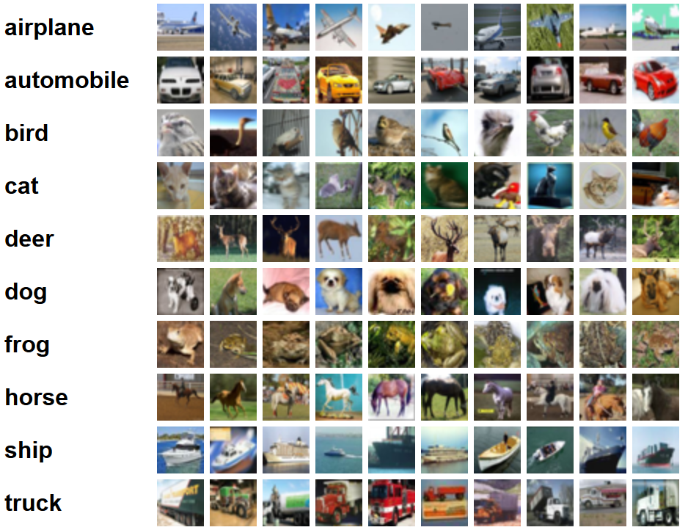
CIFAR-10
Notes:
http://www.cs.toronto.edu/~kriz/cifar.html
60000 32x32 images with 10 classes
Purpose:
A more consistent image dataset
Less time training due to smaller images

Slide 3
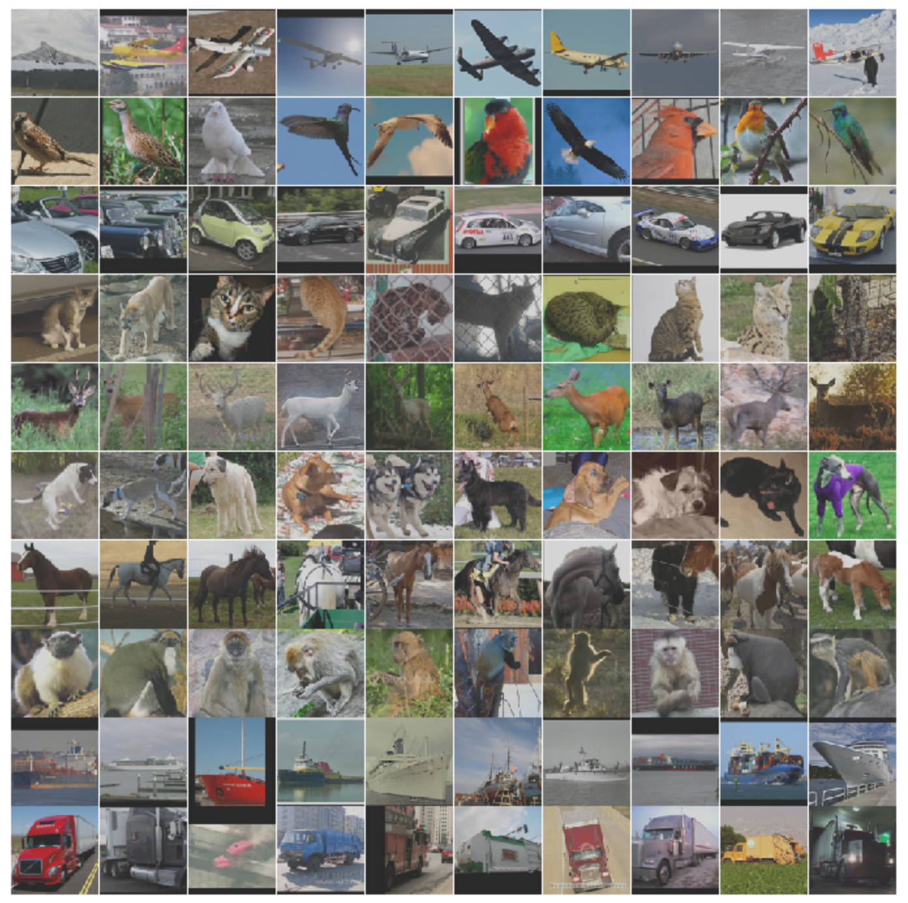
STL-10
Notes:
96x96 images that are based on the CIFAR10 dataset – possibly more noisy
Original bump was found in 64x64 images.

Slide 4
Training
Last week, I picked four diverse classes: airplanes, frogs, horses, and trucks. However, the accuracy graph was misshapen.
Training took approximately 3 hours and 30 minutes on an Intel Core i7-8550U CPU.

Slide 5
Testing
After 100 epochs, the newly combined model showed an accuracy of 0.9425.
Comparatively, the accuracy of the old combined model was 0.7968.
The accuracy increased as expected.

Slide 6
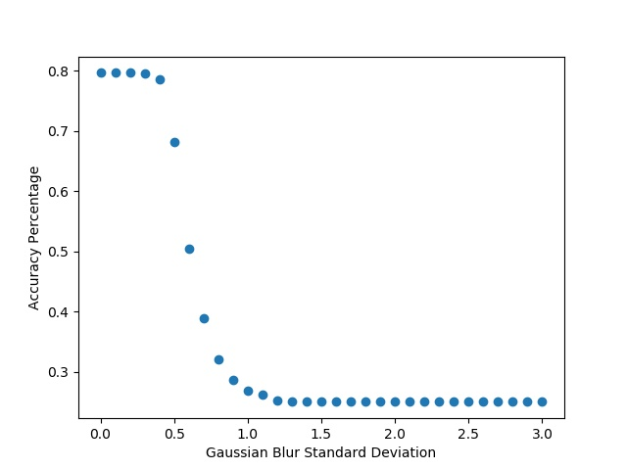
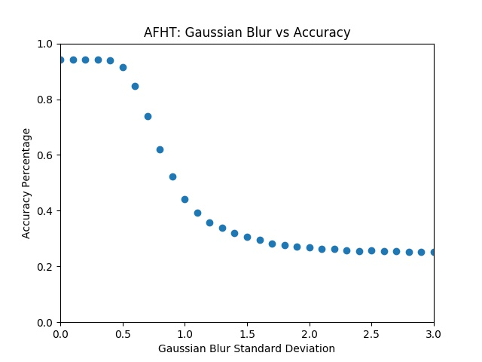
Gaussian Blur Comparison

Slide 7
Gaussian Blur Bump Analysis
I was able to train the model on STL10, which utilizes 96x96 pixel images. I used airplane, cat, deer, and truck.
The dataset consists of 500 training images per class (2,000) and 800 testing images per class (3,200).
Training the STL10 dataset took approximately 2 hours and the accuracy was 0.8983.
Comparatively on CIFAR10, training took around 2 hours and 30 minutes and the accuracy was 0.8972

Slide 8
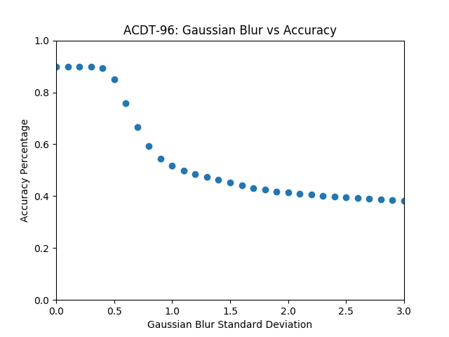
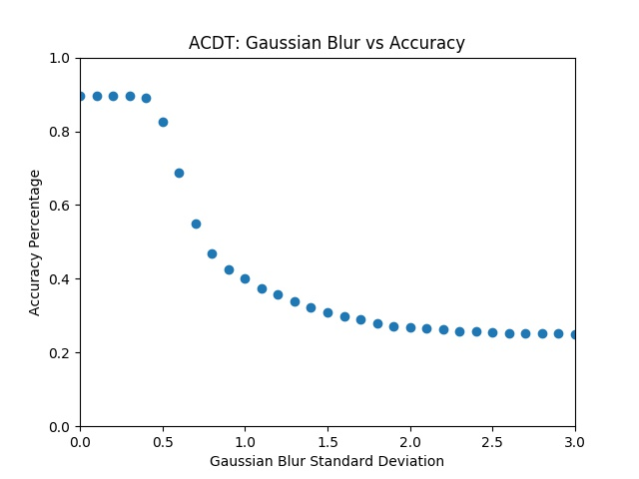
Gaussian Blur Comparison

Slide 9
Future
Option 1: Find a good dataset that has noisy images.
Option 2: Move to model that does object recognition.
Look at YOLO
Then do option 1
Do option 2 – YOLO with people (not realtime), then apply degradation
Idea: Detection with rapid degradation (brightening/darkening)

